Slide 1

CineMax Rentals Data Analysis Project: Uncovering Insights with Power BI

Slide 2

Objective
Extract sales and customer data from MySQL
Build interactive dashboards in Power BI to analyze rental trends and customer behavior and provide actionable recommendations to increase revenue in the next quarter.

Slide 3

About us
CineMax Rentals
A Leader in Movie Rentals
Mid-sized company with a vast film collection
Renowned for exceptional customer service
Years of operational experience
Rich repository of data-driven insights

Slide 4
Insights overview
Distribution of customers by city and country
Current inventory status
Analyze the rental patterns over the last year
Investigate the payments by categories
Forecast Revenue for next quarter

Slide 5
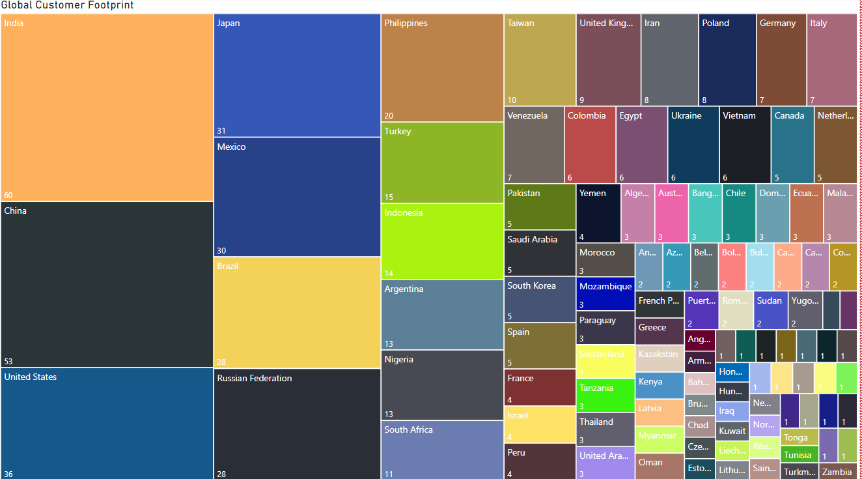
Global Customer FootPrint
Serving Customers in 109 Countries, with India, China, and US as Top Markets

Slide 6
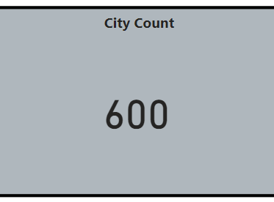
Global Presence Spanning 600 Cities, Aurora and London as Customer Hubs

Slide 7
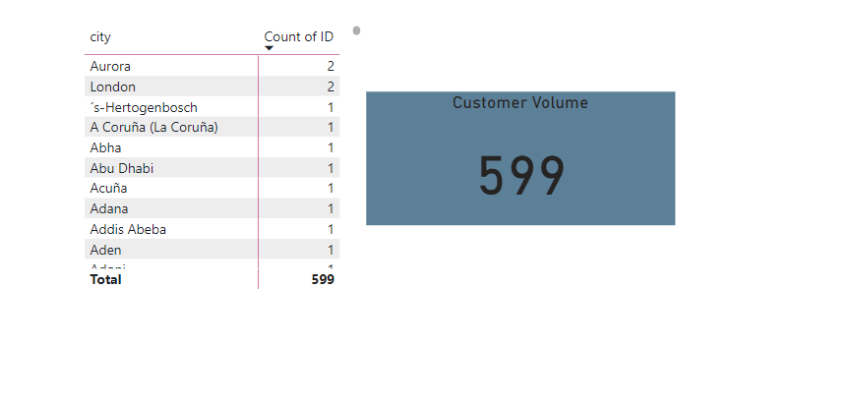
Customer Volume
Significant Customer Increase to 599 with Aurora and London dominating.

Slide 8
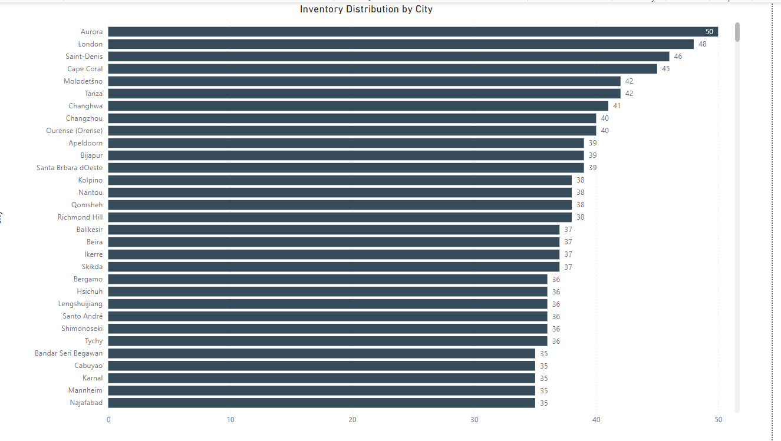
Inventory Distribution by City
At 50, Aurora had the highest number of inventories.﻿﻿ ﻿﻿ ﻿﻿Aurora had the highest number of inventories at 50,
followed by London and Saint-Denis.

Slide 9
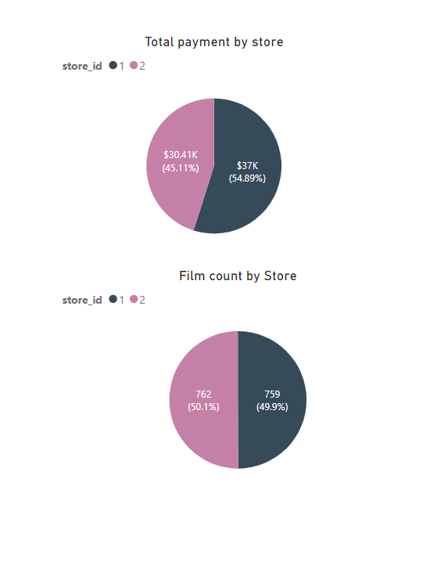
Analysis by store
Store 1 ($36,997.53) leads in Total Payments Over Store 2 ($30,409.03).
Store 2 (762 ) dominates film count with store1(759).In total there are 1521 films in both stores.

Slide 10
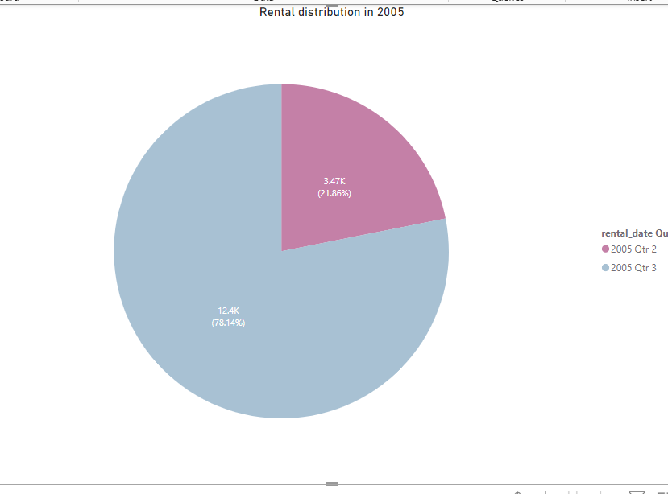
Rental Patterns over last year
Significant Increase in Film Rentals from Q2 to Q3 2005 by 56%(8930 rentals)

Slide 11
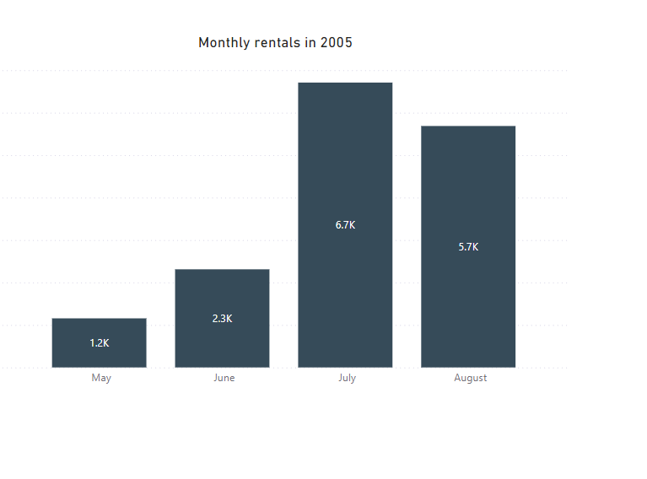
Rental Information is available from May 2005 .There are no rentals after Aug 2005 till Feb 2006.Needs more investigation. July Sees Higher Rental Volume of 6709 rentals whereas May has 1156 rentals .Increase in rentals from May to July suggest a growth of rentals.

Slide 12
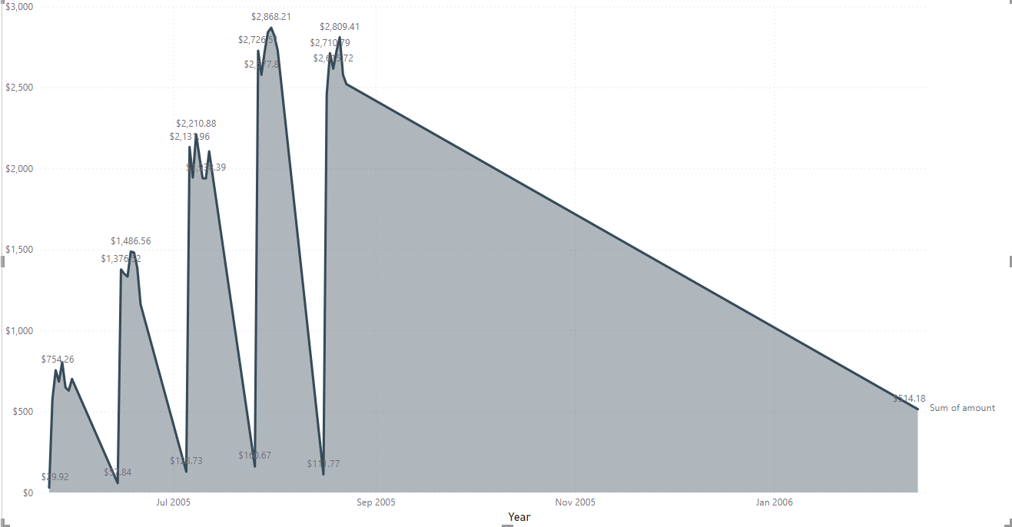
Payment Trends
Payment(Total Amount) trended up, resulting in a 1,618.52% increase between May 24, 2005, and February 14, 2006.﻿﻿ ﻿﻿ Also started trending up on, August 17, 2005, rising by 2.60% in 6 days.﻿﻿ ﻿﻿﻿﻿ ﻿﻿Sum of amount jumped from $29.92 to $2,726.57 during its steepest incline between May 24, 2005, and August 2, 2005.﻿﻿ ﻿﻿ ﻿
Payment(Total Amount) trended down, resulting in 89.34% decrease between May 2005 and February 2006.Need more investigation in decline of sales.

Slide 13
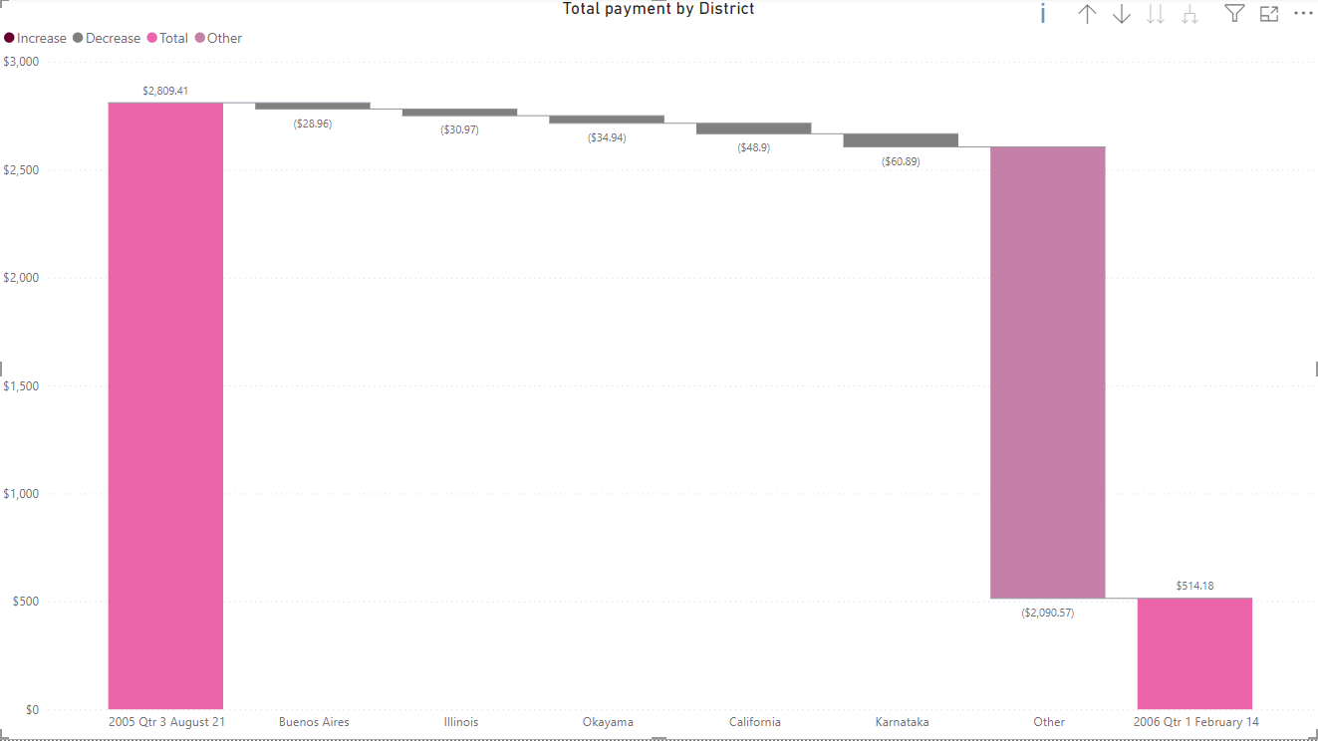
Payment Trends .. Continued
Total Payment trended down, resulting in 81.70% decrease between August 21, 2005, and February 14, 2006.﻿
Rental patterns show no rentals after August which affected the Payment trends.

Slide 14
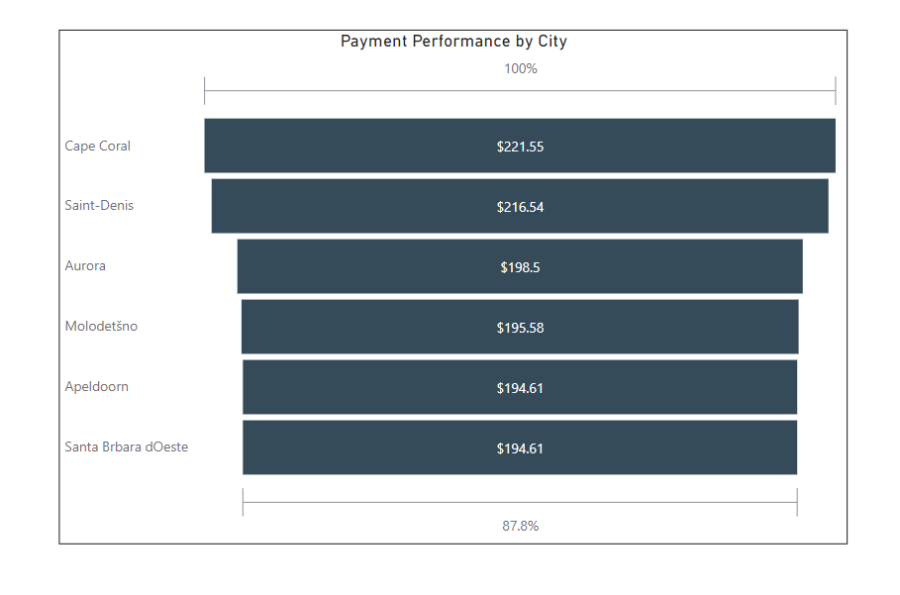
Top Cities -Payments
Top Performing Cities in Payments are Cape Coral, Saint-Denis, Aurora.

Slide 15
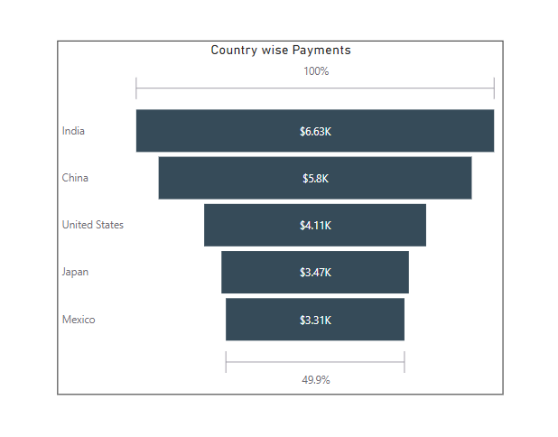
Top Countries-Payments
Top performing countries are India, China, United States, Japan and Mexico. India accounted for $6,628 leading among other countries.

Slide 16
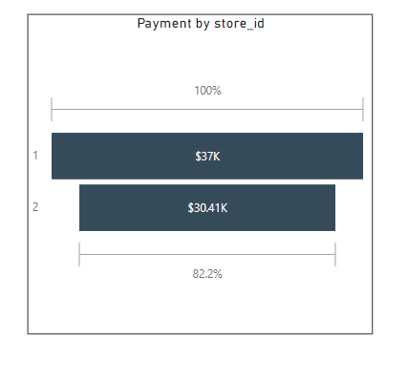
Store1 payments dominating store2 payments

Slide 17
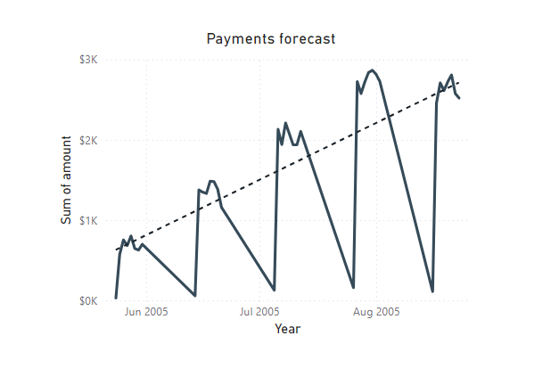
Rental and Payment Forecast
The rental data is missing from Aug 23rd, 2005, to Feb 13th, 2006 .So,forecasting the rental and payments for total record is inaccurate.
The trend line shows positive trend of payments in 2005.

Slide 18
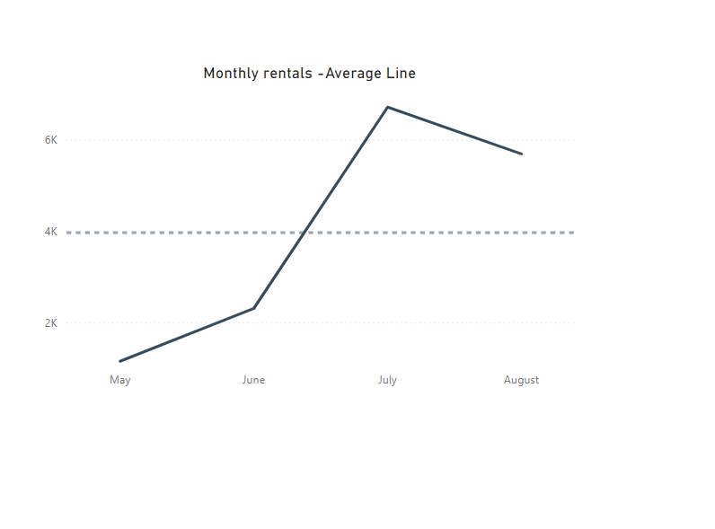
Monthly rentals
Current data insufficient for accurate forecasting. Despite a 4,000 average monthly rental, July and August 2005 has huge success in rentals.

Slide 19

Thank you
Lakshmi

